Slide 1


Slide 2
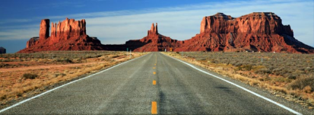

WHERE DO WE GO FROM HERE?
1. Restore Regular Order
2. Enforce Power of the Purse
3. Support “Rise of the States”
4. Hold DC Bureaucrats Accountable

Slide 3
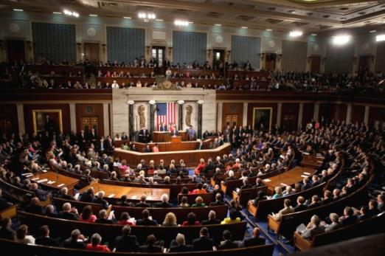
NEW HOUSE LEADERSHIP:
WHAT MUST BE DONE:
RETURN TO REGULAR ORDER
Pass all 12 appropriation spending bills
Allow for an open and accountable legislative process
Decentralize power from leadership
Push back against Obama’s job killing policies

Slide 4
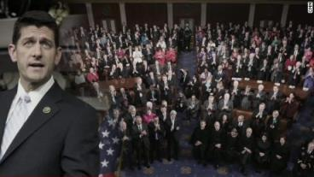
NEW HOUSE LEADERSHIP:
IT’S ABOUT FIXING THE PROCESS
YOUR VOICE is silenced when power is consolidated at the top
I will be the conscience of Speaker Ryan...
Holding him accountable for his promise of returning to regular order
Ensuring we have a transparent system that incorporates all members of Congress in important decisions

Slide 5
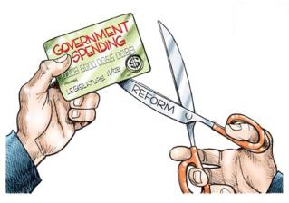
Question:
How do we stop wasteful government spending?

Slide 6
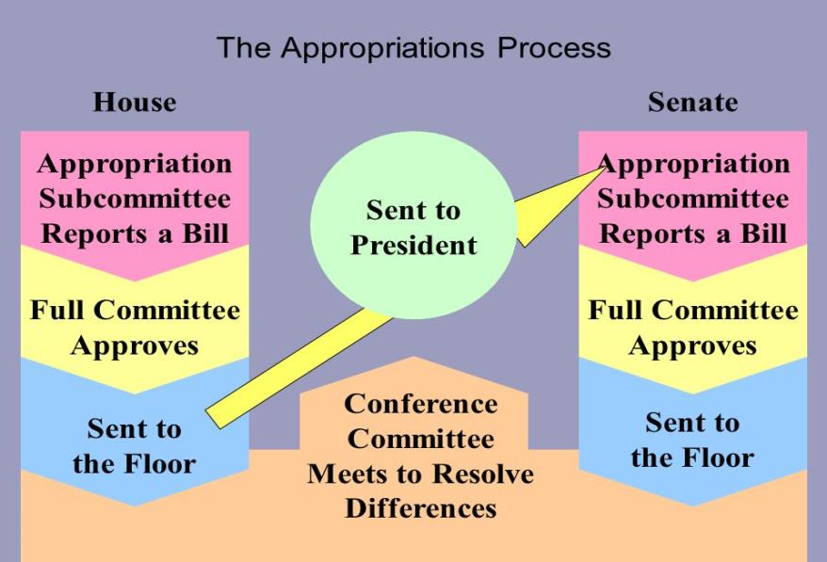
ANSWER:
THE POWER OF THE PURSE
Through this process Congress must evaluate each government program for its effectiveness
The key to cutting federal waste, fraud and abuse

Slide 7
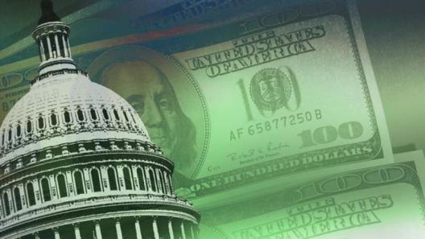
AUDIENCE PARTICIPATION:
When was the last time the Congress passed all 12 appropriation bills on time?
How many appropriations bills has the House passed this year?
How many appropriations bills has the Senate passed this year?

Slide 8

AUDIENCE PARTICIPATION:
When was the last time the Congress passed all 12 appropriation bills on time?
1997
How many appropriations bills has the House passed this year?
6 of 12
How many appropriations bills has the Senate passed this year?
0 of 12

Slide 9
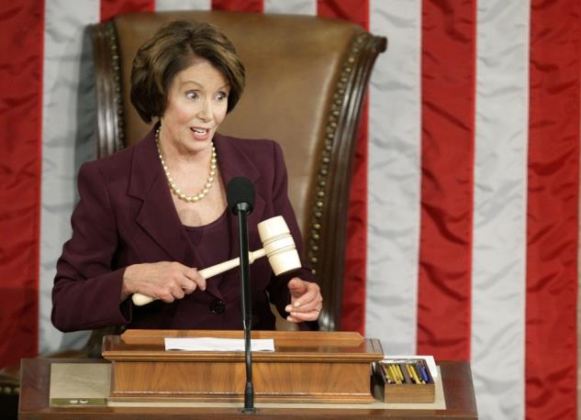
WHEN CONGRESS FAILS TO PASS Appropriations:
RESULT: CONTINUING RESOLUTION (CR)
The CR keeps all spending in place as enacted in prior Congresses
The current CR's are still re enacting most of Pelosi’s budget priorities
It takes a full budget process to cut spending

Slide 10
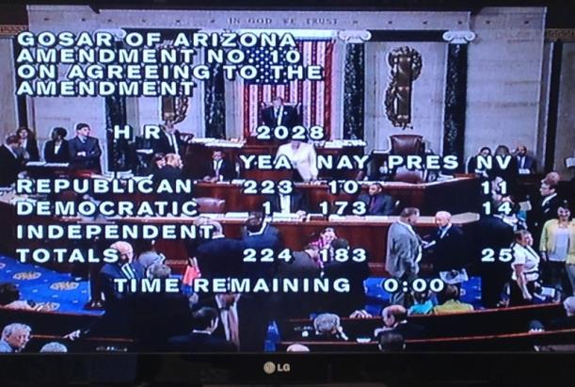
2015 Appropriations
26 Gosar amendments successfully passed
Prioritized ONLY necessary and Constitutional spending
Most effective member in the 113th Congress passing more amendments than anyone
May 2015: Gosar amendments accounted
for 16% of total amendments passed
in the House

Slide 11
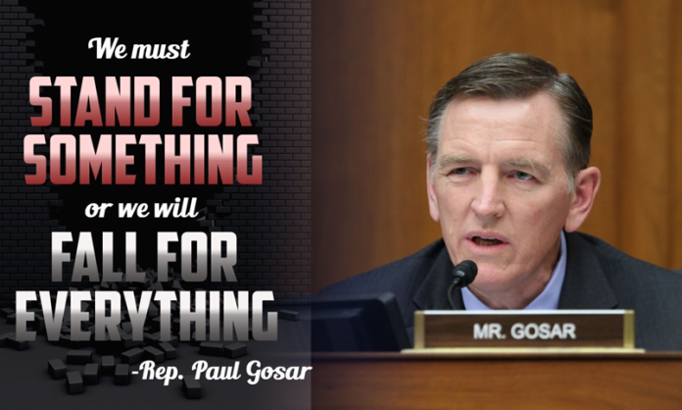
How we fight back:
Anti-deficiency act
Prohibits federal employees from involving the government in any obligation to pay money before funds have been appropriated for that purpose.

Slide 12
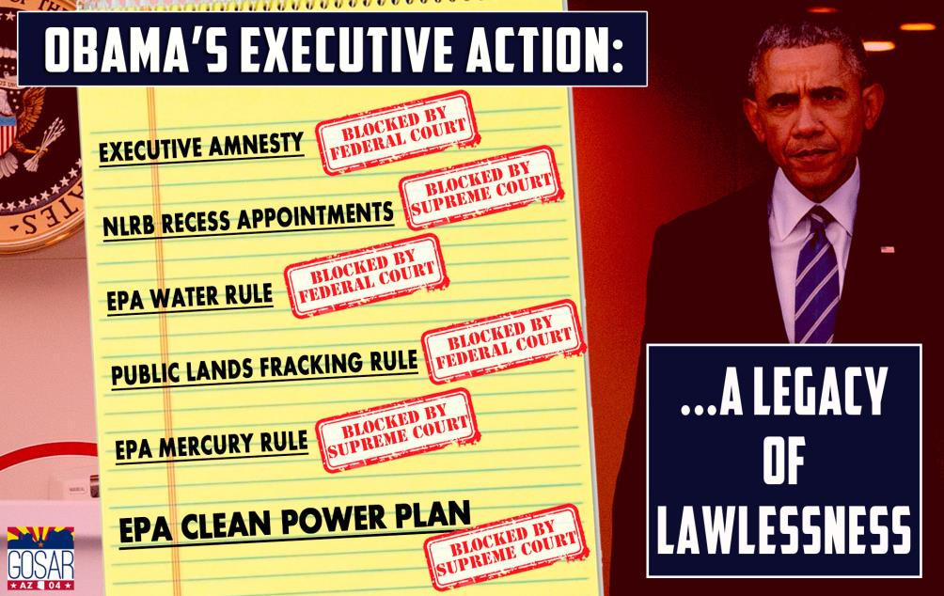
The Rise of the states
The 10th Amendment grants State governments & Federal Courts the power to combat Obama’s lawlessness

Slide 13
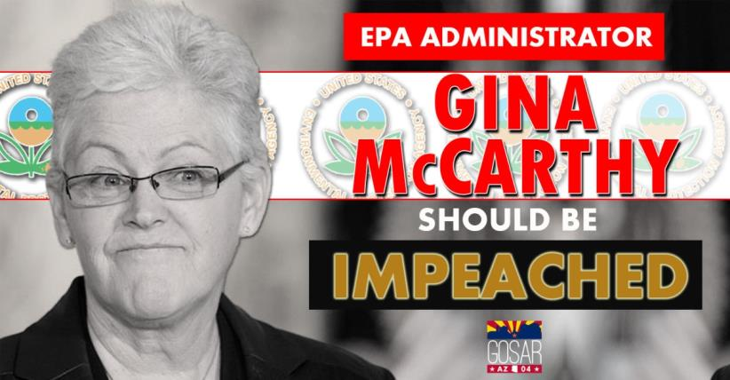
IMPEACHING EPA ADMINISTRATOR GINA McCARTHY
Congress has allowed unelected bureaucrats & executive branch officials to slowly bend & break the law to further their own partisan political agendas
McCarthy broke the law by lying to Congress in order to force misguided & overreaching regulations, which have no scientific basis, down our throats

Slide 14
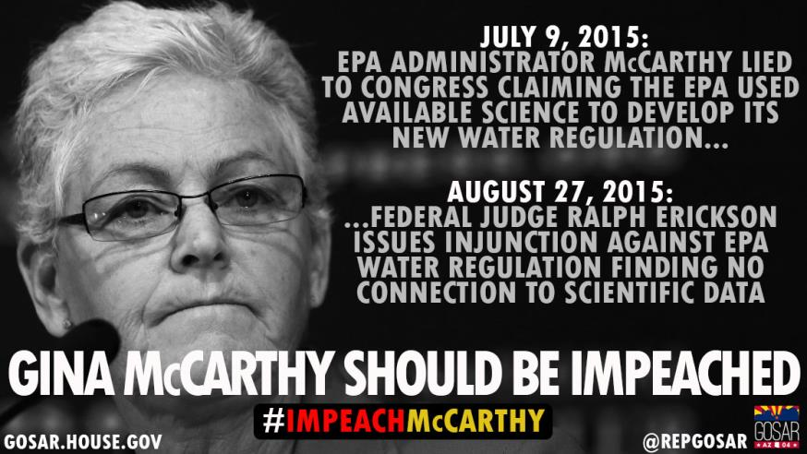

Slide 15
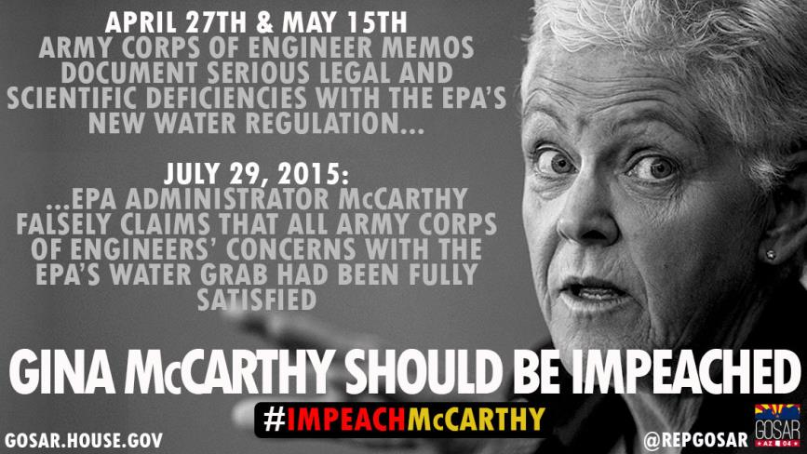

Slide 16
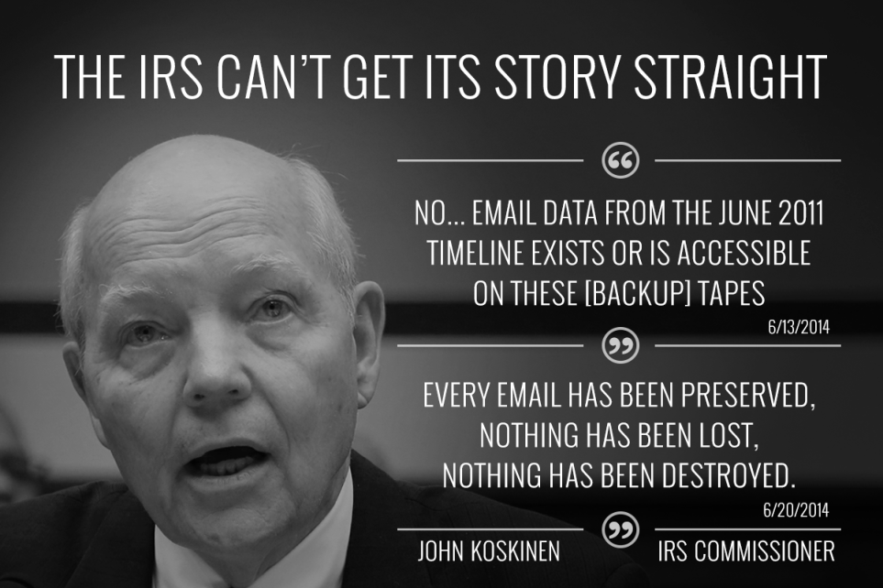
IMPEACHING IRS COMMISIONER
JOHN KOSKINEN

Slide 17
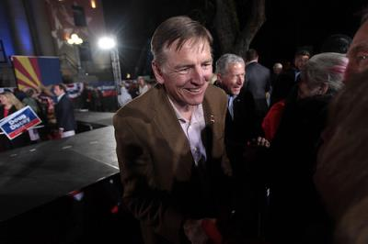




Be a part of the solution:
Continue the conversation
Follow me on social media
Facebook: facebook.com/RepGosar
Twitter: @RepGosar
YouTube: youtube.com/RepGosar
Website Gosar.house.gov

Slide 18
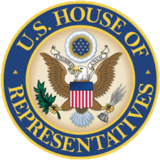
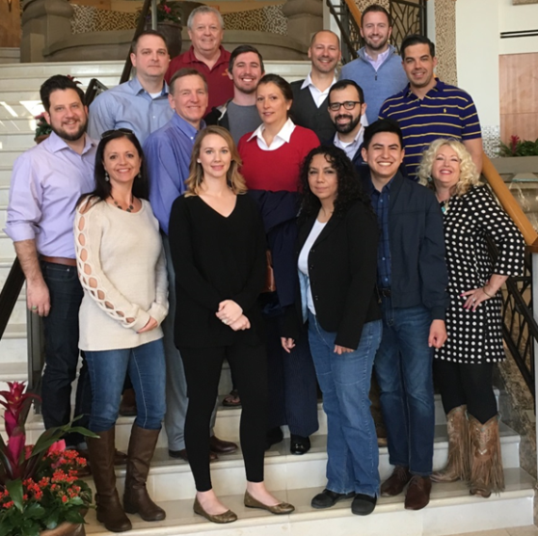

Questions
Gold Canyon Office
6499 S. Kings Ranch Rd., #4
Gold Canyon, AZ 86118
(480) 882-2697
Penny Pew, District Director
Teresa Martinez, Hispanic Coalition Director
Prescott Office
22 N. Cortez Street
Suite 104
Prescott, AZ 86301
(928) 445-1683
Julie Schreiner, Office Manager
Larry Renken, Veterans Liaison
Jeremiah Cota, Caseworker

Slide 19
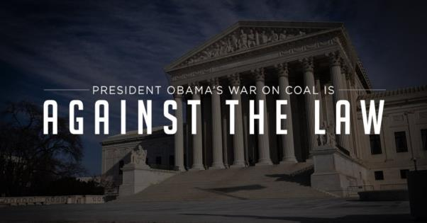

CLEAN POWER PLAN
EPA’s War on Coal: forcing states to reduce power-sector carbon-dioxide emissions rates by impossible amounts before 2030
American families are projected to lose almost $600 billion in disposable income as a result
According to the U.S. Chamber of Commerce Institute for 21st Century Energy, all of this economic harm and destruction for our economies will only result in a 1.8% reduction of global carbon-dioxide emissions

Slide 20
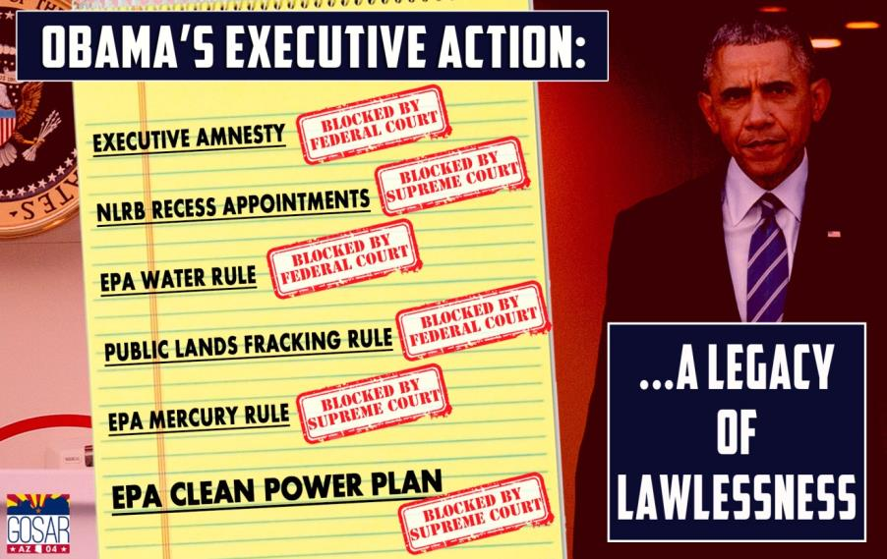
CLEAN POWER PLAN
TUESDAY FEBRUARY 9, 2016: Supreme Court blocks implementation while 26 states, including Arizona, challenge this regulation in federal court

Slide 21
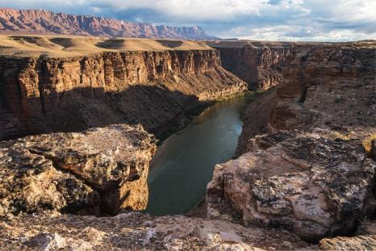
PROTECTING LOCAL COMMUNITIES FROM EXECUTIVE OVERREACH
Obama has designated 22 national monuments locking up more than 3 million acres of land with one stroke of his pen
Designations that circumvent Congress result in devastating consequences for future economic prosperity
Local stakeholders deserve to have a say regarding the use of public land near their communities
Grand Canyon Watershed

Slide 22
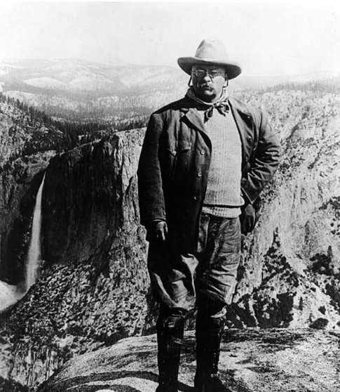
PROTECTING LOCAL COMMUNITIES FROM EXECUTIVE OVERREACH ACT
Blocking Presidential Abuse Of The Antiquities Act
H.R. 3946 Blocks effort to lock up 1.7 million acres in the Grand Canyon Watershed
Antiquities Act - abused in order to appease special-interest groups and bypass the legislative process
Antiquities Act first signed into law by
President Theodore Roosevelt in 1906

Slide 23
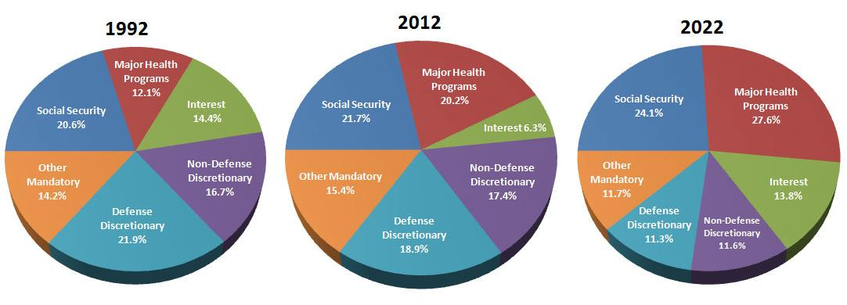
FEDERAL SPENDING BREAKDOWN
$2.079 trillion
$3.563 trillion
$4,939 trillion
Notes:
Here’s one way to look at the national situation as if it were a business and you were considering buying part of that business.
Its costs will rise faster than its forecast income during the next 20 years.
Its primary sectors for future growth are facing serious headwinds that will lead to less and less investment.
It will spend more on retiree benefits within the decade than on any other single item and these costs are rising more rapidly than any other part of this company’s business.
Its indebtedness has doubled as a proportion of its costs in just the past six years and interest payments will exceed all investments in its products within the decade.
Most of this company’s debt is owned by dangerous competitors who may at any time demand higher interest rates.
It has substantial assets, but getting rid of those real assets and trimming non-core spending has proved virtually impossible because the CEO and his Board of Directors fear that shareholders will fire them if they engage in these necessary reforms.

Slide 24

TRANS-PACIFIC PARTNERSHIP
Too much secrecy in the negotiations
Final bill is too large and too complex
Too many things folded into what should be a straightforward trade deal
Incorporates future international global warming deal with no Congressional approval
Go back to square one and start over
We must support free trade but TPP is a bad deal for Americans

Slide 25


SYRIAN REFUGEE RESETTLEMENT
  House action:
SAFE Act – strengthens vetting system for refugees
Visa Waiver Program Improvement and Terrorist Travel Prevention Act
Refugee crisis will only be solved when the president ARTICULATES AND EXECUTES A REALISTIC STRATEGY TO DESTROY ISIS

Slide 26
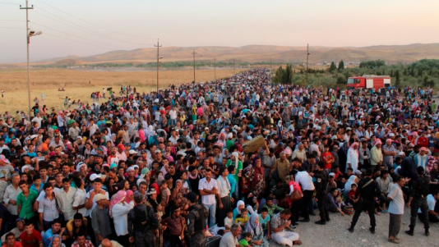
SYRIAN REFUGEE RESETTLEMENT
FBI & Department of Homeland Security have told Congress they do not have the necessary intelligence to properly vet refugees from Syria
The first responsibility of the Federal Government: KEEP THE AMERICAN PEOPLE SAFE
Until there is a certification process in place to prevent terrorist threats, the refugee program should be PAUSED

Slide 27
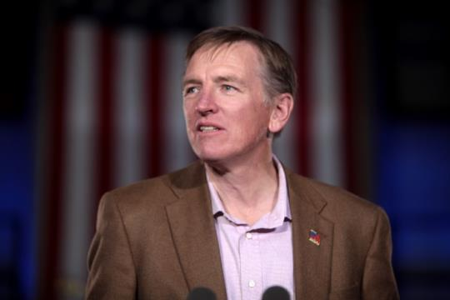
TAKING A STAND:
Did not vote for John Boehner as Speaker of the House
Successfully cut $1 billion in spending with 2014 House passed amendments
Voted against raising the debt ceiling
Voted against executive amnesty – Stopping DHS appropriations bill
Introduced bill for removal of former AG Eric Holder
Introduced Articles of Impeachment for EPA Administrator Gina McCarthy

Slide 28

Military Construction and Veterans Affairs Appropriations Act - Gosar Amendments
1) Prohibited loophole hiding delays for veterans medical care
2) Prioritized funds to upgrade VA IT Systems
3) Improved efforts to reduce claims backlog
4) Provided additional resources to the Board of Veterans Appeals

Slide 29
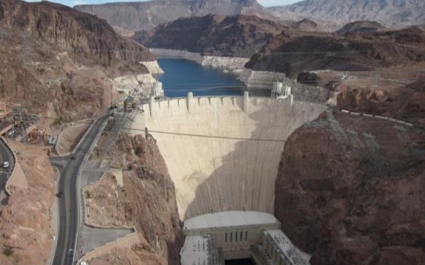
Energy and Water Development Appropriations Act - Gosar Amendments
1) Blocked $18.7 million for new Climate Model Program
2) Supported the Inspector General at Department of Energy
3) Protected important federally-owned dams
4) Cut wasteful spending to support the Corps of Engineers Construction Budget and...
5) Corps of Engineers Investigations budget to reduce the backlog of projects

Slide 30
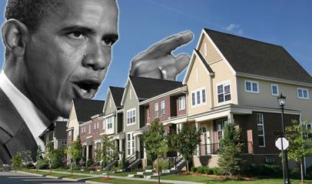
Gosar amendment:
Protecting Local Zoning Rights
from Federal Overreach
New Obama Regulation:
Affirmatively Furthering Fair Housing (AFFH)
Attempts to reengineer local communities to fit utopian racial and economic quotas
AFFH would increase local taxes, depress property values
June: Gosar Amendment successfully passes House to block AFFH
Local zoning decisions should always be, made by local communities, NOT bureaucrats in Washington DC

Slide 31
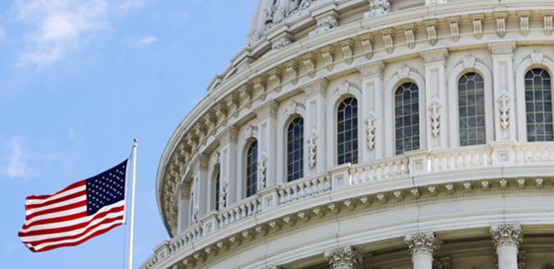
LEGISLATIVE UPDATES

Slide 32
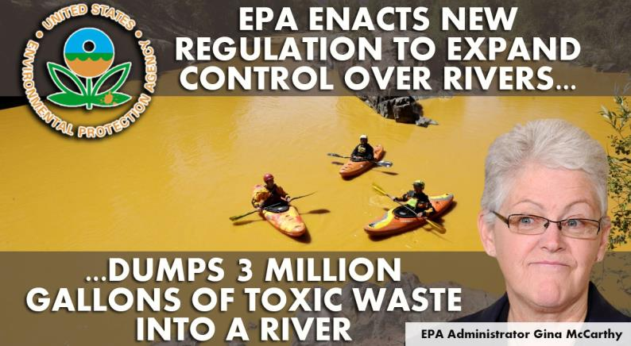

Slide 33

Epa’s New water rule
Waters of the U.s.
EPA overreach: Expands the Clean Water Act and seizes control of our water resources
Unilateral regulation that directly contradicts prior Supreme Court decisions
Will harm agriculture, small businesses, property owners, municipalities and water users throughout the country
Arizonans can't afford more economic
hurdles and thieveries of precious
water resources

Slide 34
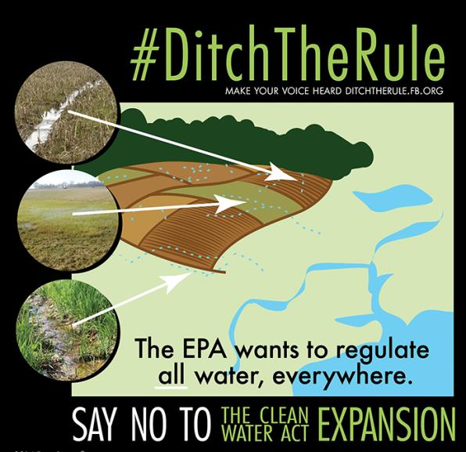
Fighting back to block WOTUS
5/1/14 Letter to EPA, withdraw the rule
6/2/14 Field hearing in Phoenix, 9 witnesses
1/28/15 Introduced the Waters of the U.S. Regulatory Overreach Protection Act
5/12/15 House passes legislation blocking rule
7/7/15 Gosar WOTUS rider in two appropriations bills
- I also defeated an amendment to strip my rider
8/27/15 Federal Judge temporarily blocks WOTUS
Only Congress has the authority to change the CWA…
NOT bureaucrats in DC

Slide 35

COMPETITIVE HEALTH INSURANCE REFORM ACT
Restores competition among health insurance companies
Amends McCarran-Ferguson Act which exempted the health insurance industry from anti-trust laws
Dentists are not allowed to collude to set prices or monopolize healthcare... Insurance companies should not be allowed to either
This will expand competition and lower prices

Slide 36

COMPETITIVE HEALTH INSURANCE REFORM ACT
Important first step towards replacing Obamacare
Results in lower prices and more individual control over YOUR health care
Gives consumers more choice and will help fix Medicare and Medicaid

Slide 37

BOTTOM LINE:
Our Focus On Healthcare Must Be:
  Keeping and Expanding the Marketplace
  Empowering Patient Centered Legislation
  Allowing Consumers the Freedom to Choose

