Slide 1



ARIZONA LEGISLATIVE UPDATE
2026 RECAP

Slide 2
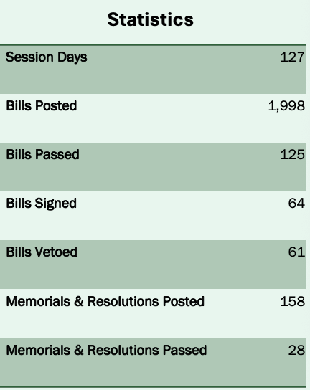
SESSION SNAPSHOT
FIFTY-SEVENTH SECOND
REGULAR SESSION
House Reconvenes: June 1, 2026 @ 1:30pm
Senate Reconvened: May 18, 2026 @ 1:15pm
SESSION ACTIVITY AT A GLANCE
Nearly 2,000 bills introduced during the 2026 session
Vetoes remain historically significant with 61 gubernatorial vetoes
Legislature approaching late-session negotiations and budget activity

Slide 3
BILL POSITIONS
Legislative Position Overview, 20 Priority Measures Reviewed
Primary Policy Categories:
Support Positions: 14 bills
Water Policy
Infrastructure
Economic Development
Taxation
Education
Opposition Positions: 6 bills
Legislative priorities focused on regional growth, infrastructure and long-term water reliability.

Slide 4

WATER AND POWER LEGISLATION
Support:
HB2827 | groundwater withdrawal
fee; Pinal AMA – died in Senate
SB1560 | cap; water supply; development fund – waiting for Senate vote
HB2098 | county water augmentation
authorities; bond - SIGNED
SB1447 | groundwater withdrawal
fee; Pinal AMA – mirror bill to HB2827 – waiting for House vote
HCR2038 | Colorado River;
seven-state agreement – died in Senate

Slide 5
WATER AND POWER LEGISLATION
Opposition:
HB2934 | Harquehala; groundwater
transportation fee – died in the House
HB2452 | comprehensive plans; data
centers; nuclear – died in the House

Slide 6
INFRASTRUCTURE & TRANSPORATION
Infrastructure – Support
Transportation – Support
HB2999 – Su port
state housing affordability districts
HB2106 - Support
transporation tax; deposit; county board
HB4026 - Support
public infrastructure improvements; distribution limit
Local Government
HB2496 - Oppose
revitilzation districts; construction contracts
SB1137 - Support
underground facilities; exavations; notifications
HB2824 - Support
capital improvement; financing program

Slide 7
Outstanding Priority Bills and Policy
35% ($4 million) reduction in collections for statewide 911 funding, affecting cities and towns.
Cities and towns cannot afford to fill this gap; advocating for $4 million in stopgap (general fund) funding and a study to determine long-term costs.
This funding is crucial for maintaining 911 services, which are essential for public safety.
SB1200 – assured water supply; certificate; model (Shope) – waiting for Senate vote
Allows certain man-made lakes or water features built before January 1, 2026, to reuse treated wastewater (effluent) by mixing it with other water for landscaping and similar uses.
Requires owners/operators to track how much water goes in and out each year, replace the reused water with enough treated wastewater, and report those totals annually to the state.
HB2999 – s/e infrastructure finance district (Weninger) - awaiting final read in House
Creates state housing affordability districts that can finance and build infrastructure to support new housing and economic development projects, while keeping local cities and counties in control of zoning and land-use decisions.
Allows districts to raise funding through taxes, assessments, and bonds for infrastructure projects, sets limits on debt and tax rates, requires public disclosures and homeowner notices, and establishes rules for district governance, boundary changes, and eventual dissolution once obligations are paid off.

Slide 8
BUDGET NEGOTIATIONS: KEY POINTS
Governor Katie Hobbs vetoed the Republican-passed $17.9B state budget, restarting negotiations. The Governor’s Office called the proposal “unbalanced and reckless.”
Republicans included roughly $600M in additional tax cuts that the Governor opposed.
Democrats and the Governor raised concerns the proposal could impact Medicaid and food assistance eligibility for approximately 200,000 Arizonans.
Budget negotiations are now back at the table between legislative Republicans and the Governor’s Office.
The House has recessed until June 1, slowing movement on remaining legislation.
Arizona lawmakers must pass a final budget before the June 30 constitutional deadline.
Major issues still under negotiation:
•Tax cuts
•Medicaid and social services
•Education funding
•Infrastructure and water investments
The budget fight continues to highlight divided government tensions at the Capitol.

Slide 9
WHAT CHANGED SINCE THE BEGINNING OF SESSION?
Budget & Affordability Pressures
This became even more dominant than expected and is now the defining issue of session.
Budget negotiations completely broke down at points, including Governor Hobbs’ bill-signing moratorium and veto of the Republican budget proposal.
The fight shifted from general affordability messaging to a direct battle over:
Tax conformity with federal H.R. 1
Medicaid and SNAP reductions and backfilling federal cuts.
Agency cuts (GOP budget includes 5% cuts to almost every agency)
Utility and housing affordability programs
Affordability is now being framed by both parties very differently:
Republicans want tax cuts and smaller government
Democrats/Hobbs targeted middle-class relief and protecting services
Tax Conformity / Federal H.R. 1
Republicans pushed near-full conformity with federal tax cuts.
Hobbs supported only partial conformity focused on middle-class tax relief.
Revenue loss concerns became central, with projections of major long-term budget impacts.
Tax conformity evolved from a technical tax issue into one of the biggest ideological fights of session.

Slide 10
WHAT CHANGED SINCE THE BEGINNING OF SESSION?
Proposition 123 & Education Funding
Still unresolved and arguably more contentious now.
Instead of a straightforward renewal discussion, negotiations became tied to:
ESA/voucher protections
school funding formulas
teacher pay
broader budget negotiations
Prop 123 became leverage in the broader budget war rather than a standalone education discussion.
Water Policy & Colorado River Negotiations
Remained highly important and arguably intensified.
Water management became more aggressive political:
new AMA creation in La Paz County
stronger groundwater oversight
increased scrutiny of high-water-use industries
Colorado River negotiations remained bipartisan compared to most other issues.
Data centers became directly tied to water policy debates.

Slide 11
2027 OUTLOOK
Pinal County remains central to Arizona’s long-term growth strategy
Water and infrastructure will continue driving legislative debate
Fiscal constraints likely to increase competition for state resources
Economic development opportunities remain strong
Regional coordination and proactive advocacy will be increasingly important

Slide 12

THANK YOU
VERY MUCH

